Slide 1
Background of the aids dataset
A randomized clinical trial in which both longitudinal and survival data were collected to compare the efficacy and safety of two antiretroviral drugs in treating patients who had failed or were intolerant of zidovudine (AZT) therapy.
A data frame with 1405 observations on the following 12 variables.
Variable Name | Description
patient | patients' identifier; in total there are 467 patients.
Time | the time to death or censoring.
death | a numeric vector with 0 denoting censoring and 1 death.
CD4 | the CD4 cells count. The higher the CD4 cells count, the better the survival rate.
obstime | the time points at which the CD4 cells count was recorded.
drug | a factor with levels ddC denoting zalcitabine and ddI denoting didanosine.
gender | a factor with levels female and male.
prevOI | a factor with levels AIDS denoting previous opportunistic infection (AIDS diagnosis) at study entry, and noAIDS denoting no previous infection.
AZT | a factor with levels intolerance and failure denoting AZT intolerance and AZT failure, respectively.
start | The start time of an interval during which an event may occur. In the context of survival analysis, it marks the time at which an individual begins to be at risk. The values for start is the same as the values for 'Obstime'.
stop | The end time of the interval. It is the time at which the individual is no longer at risk for the event (e.g., due to experiencing the event, censoring, or the end of the study).
event | Indicates whether the event of interest occurred. When death = 1 and stop time is the same as the Time => event is ‘1’

Slide 2
R1: Does the effect of a drug on the occurrence of an event (e.g., disease progression or death) change over time?
Dynamic drug effects:
Drug effects can be complex and may vary over time. Some drugs can be complex and may vary over time. Some drugs may have immediate effects.
Clinical implications:
Early intervention: Identifying when a drug is losing effectiveness can lead to early intervention with alternative treatments, potentially improving patient outcomes.
Safety monitoring: Monitoring changes in drug effects over time can help identify potential safety concerns or adverse events.
Model to use: Generalized Estimating Equations (GEE)
Clustered data where the patients within each cluster are correlated since same patient is measured repeatedly over time on CD4 count
The binomial distribution is used to model the outcome variable when the response (i.e. event) is binary (e.g., 0 or 1).
The correlation structure may be appropriate to use ar1 because repeated measures taken at obstime at equally spaced times work best using ar1.

Slide 3
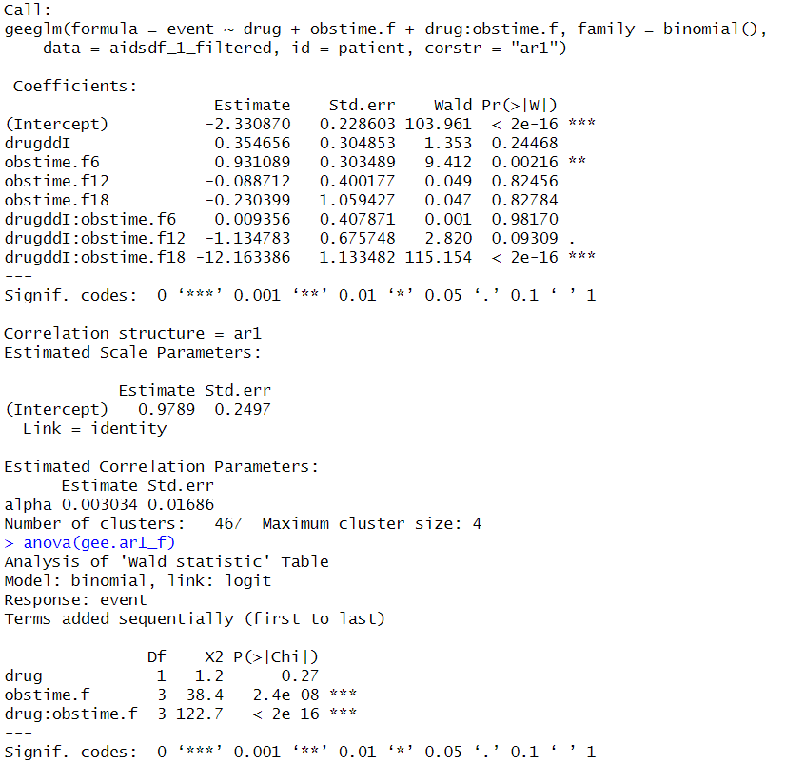
Preliminary results and analysis
Removing obstime: 2 such that the time points are evenly paced (i.e. 0, 6, 12, 18 months)
 | ar1 | unstructured | exchangeable
Original dataset
QIC scores | 1067.64 | 1067.49 | 1067.27
Std.err | 0.193 | 0.134 | 0.178
After removing rows where obstime=2
QIC scores | 762.567 | 762.31 | 762.42
Std.err | 0.2497 | 0.212 | 0.243
At the time stamp of 6 months and the interaction of drugs and time stamp of 18 months is statistically significant on the effects on the outcome.
The negative coefficient (-12.163386) suggests that individuals who received the drug drugddI at 18 months are significantly less likely to experience the outcome (i.e., disease progression or death) as compared to individuals who received the drug at the reference level (0 months).
Notes:
Qn: Do we interpret the top or the bottom? Because the bottom shows that drug does not have much effect on the outcome but the interaction of drug and time at 18months show that there is significance and it reduces the possibility of disease progression or deaths.

Slide 4
Expand on this and explore other research questions
Does the effect of a drug on the occurrence of an event change over time, and how are these effects influenced by gender?
Does the effect of a drug on the occurrence of an event change over time, and how are these effects influenced by gender and AZT?
Does the effect of a drug on the occurrence of an event change over time, and how are these effects influenced by gender, AZT and previous opportunistic infections (prevOIAIDS)?
Notes:
Want to ask the Prof since adding more covariates can improve the QIC scores -> how do we know that when we add it is not due to overfitting issues? In this slide -> there are more factors that are significant

Slide 5
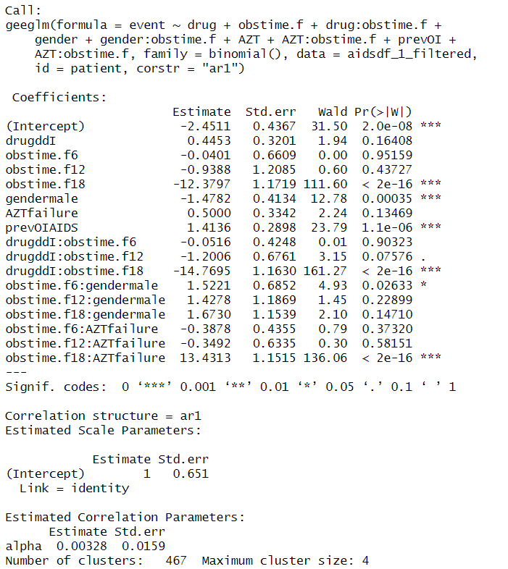
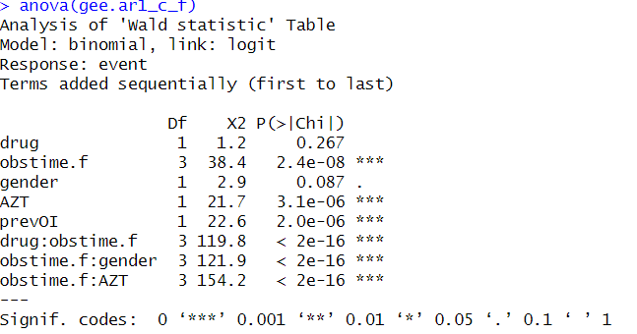
Preliminary results and analysis
The coefficient for gendermale is -1.4782 this suggests that males have a significantly lower risk (e^(-1.4782) ≈ 0.229) 77.1% less likely to experience the event as compared to females.
This effect is consistent across different time points, suggesting that the observed gender difference is not due to time-varying effects of the drug or other factors.
Individuals with a previous AIDS diagnosis are approximately 64.9% more likely to experience the event compared to those without a previous diagnosis.
This finding highlights the importance of considering prior medical history when assessing the risk of adverse outcomes in patients with HIV/AIDS.

Slide 6
R2: How does CD4 cell count change over time for patients on ddC and ddI?
Why Assessing Time-Varying Drug Effects is Critical?
When studying drug effects, it's essential not just to understand if a drug works, but how its effectiveness changes over time.
Clinical implications:
Treatment Adjustments: Identifying time-dependent drug effects allows clinicians to adjust doses, switch therapies, or introduce combination treatments at the right moments.
Improved Patient Outcomes: Understanding how drug effects evolve over time helps optimize long-term treatment plans, reducing risks and maximizing benefits.
Research and Drug Development: Time-dependent analysis helps researchers identify which drugs are suitable for short-term vs. long-term treatment.
Model to use: Generalized Estimating Equations (GEE)
Clustered data where the patients within each cluster are correlated since same patient is measured repeatedly over time on CD4 count
The gaussian distribution is used to model the outcome variable when the response (i.e. CD4 cell count) seems normally distributed.
The correlation structure may be appropriate to use ar1 because repeated measures taken at obstime at equally spaced times work best using ar1.

Slide 7
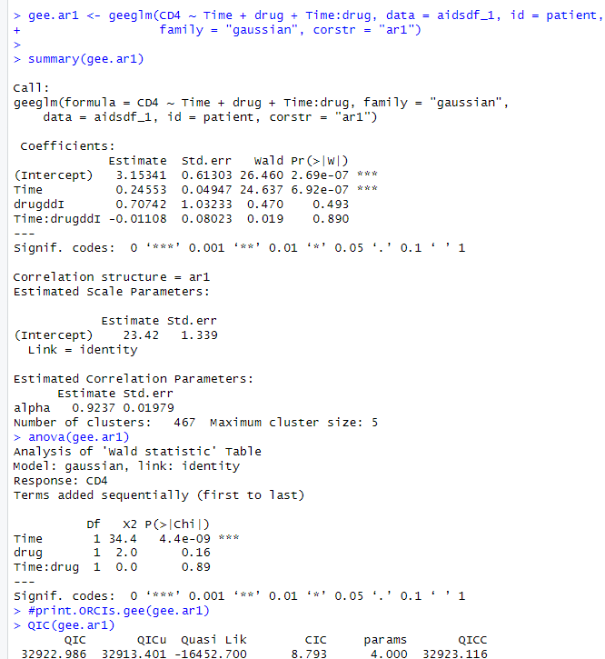
Preliminary results and analysis
 | ar1 | unstructured | exchangeable
QIC scores | 32922.986 | 33272.84 | 32878.47
Std.err | 1.339 | 1.36 | 1.34
Summary of Coefficients:
Intercept: The estimate of the intercept (3.15341) represents the baseline CD4 count at time zero.
Time: The estimate for the effect of time (0.24553) is positive and highly significant (p<0.001). This suggests that, on average, CD4 count increases over time regardless of the drug.
Drug (ddC and ddI): There are two estimates:
drugddI (0.70742) shows the effect of taking ddI compared to a reference category (ddC). This positive coefficient implies that ddI is associated with a higher CD4 count compared to the reference, and the significance of p=0.49 indicates this might not be statistically significant.
Interaction (Time): The interaction term between time and the ddI drug (-0.01108) indicates a slight reduction in the effect of time on CD4 count when using ddI compared to the reference category. However, this effect is not statistically significant (p=0.89).
The ANOVA table and p-values indicate that the effect of time is the most statistically significant factor influencing CD4 count changes, while the direct effects of the drug and its interaction with time do not seem to significantly impact CD4 counts in this analysis.

Slide 8
R3: Do factors like gender, prevOI, and AZT factors influence CD4 cell count changes?
Key Predictors of Treatment Response:
Gender Differences: Biological and physiological differences between males and females can lead to variations in immune responses and drug metabolism, which may influence the progression of diseases like HIV or the response to specific treatments. Understanding these differences helps tailor interventions more effectively for both genders
Previous Opportunistic Infections (prevOI): Patients who have had previous opportunistic infections might have a more compromised immune system. Investigating whether past infections are associated with differences in CD4 recovery or progression helps in assessing the long-term impact of those infections on immune function.
AZT Use: AZT (Zidovudine) was one of the earliest antiretroviral drugs used in HIV treatment. It’s essential to assess whether prior or ongoing use of AZT affects the CD4 cell count, as long-term use could have residual impacts or interactions with other treatments.

Slide 9
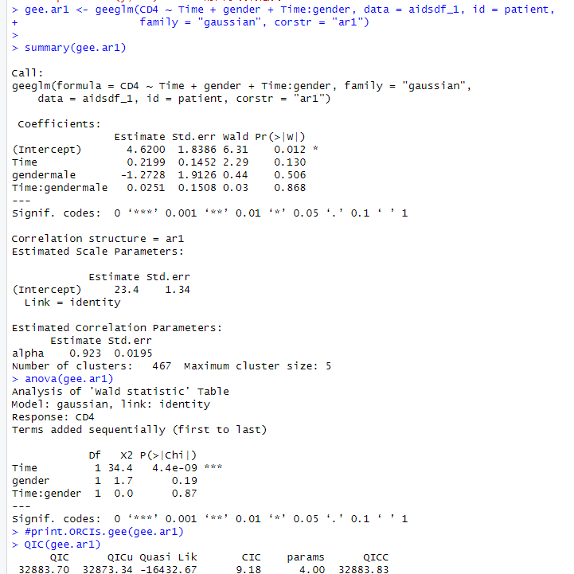
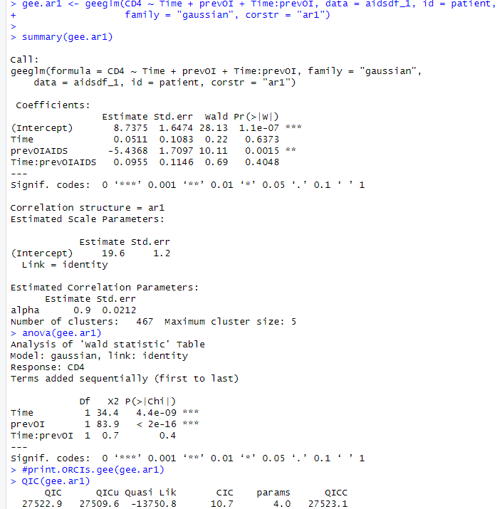
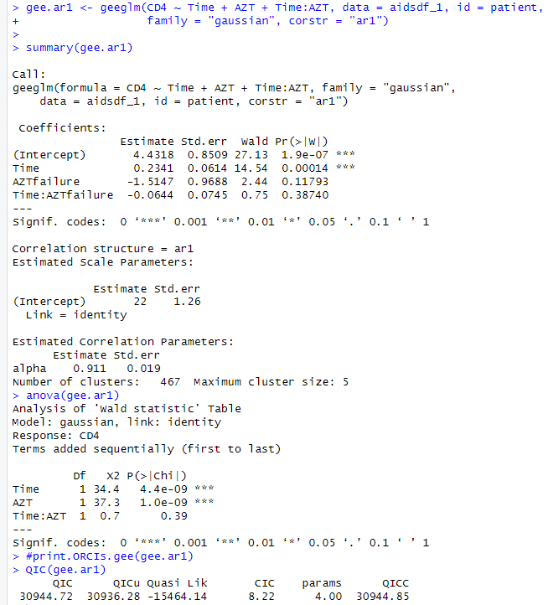
Preliminary results and analysis
 | Gender | prevOI | AZT
QIC scores | 32883.70 | 27522.9 | 30944.72
Std.err | 1.34 | 1.2 | 1.26
Notes:
Last graph AZTfailure (on top shows no significance) but the bottom shows significance -> how to interpret this?

Slide 10
Summary of Coefficients:
Key Takeaways:
Time Effects: Across all models, the effect of time on CD4 count shows a positive trend, though its significance varies depending on the context.
Gender: Gender does not show a statistically significant influence on CD4 changes in the data you analyzed.
PrevOI: A history of previous opportunistic infections has a significant negative impact on CD4 count levels, indicating a more compromised immune status for these patients.
AZT: Experiencing AZT failure suggests a lower CD4 count, though it’s not statistically significant in this model.
These summaries suggest that previous opportunistic infections have the most statistically significant impact on CD4 counts among the factors you analyzed. Time consistently shows a positive trend in influencing CD4 counts, while other interactions and direct effects like gender and AZT failure appear less impactful based on this analysis.

Slide 11
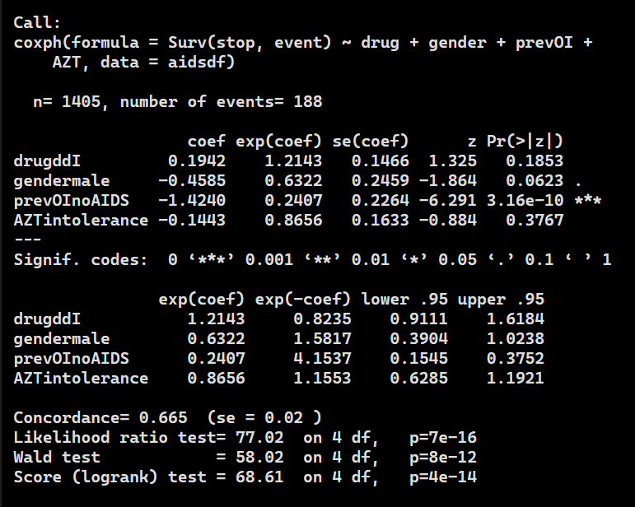
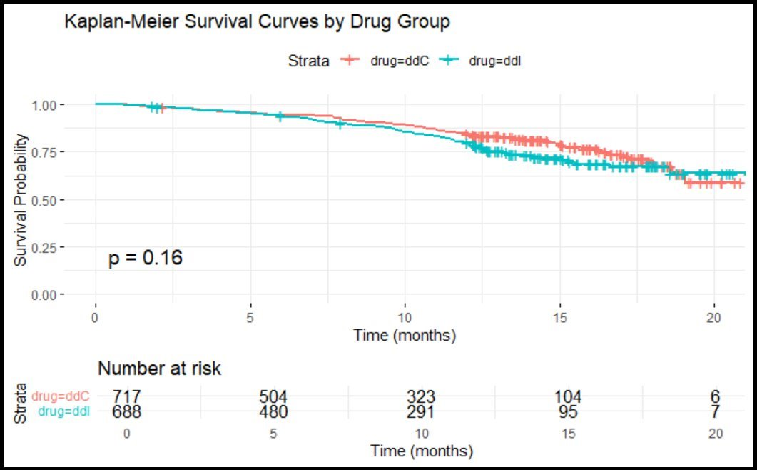
R4: Does the rate of survival increase with the use of one medicine over another?
Null Hypothesis (H0): There is no difference in survival between patients treated with ddC and ddI.
Alternative Hypothesis (H1): There is a significant difference in survival between patients treated with ddC and ddI.
Coefficient (coef): 0.1942
Hazard Ratio (exp(coef)): 1.2143
p-value: 0.1853 (not significant)
Interpretation:
The hazard ratio for drug (ddI vs ddC) is 1.2143, suggesting that patients treated with ddI have a 21.4% higher risk of death compared to those treated with ddC.
The result (p = 0.1853) is not statistically significant, suggesting that the difference in survival between the two drug groups may be due to chance; thus, we do not reject the null hypothesis of drug type not affecting survival.

Slide 12
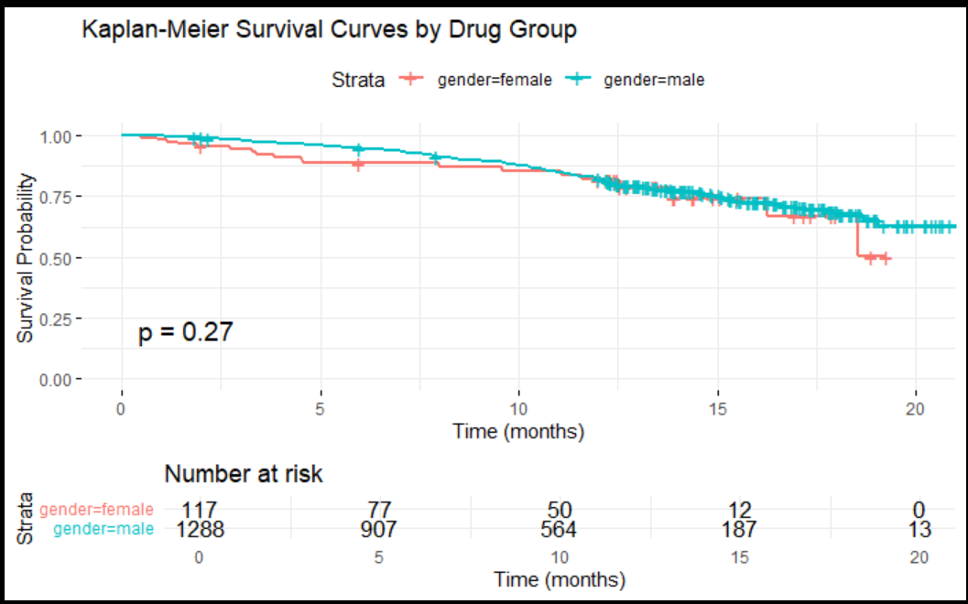
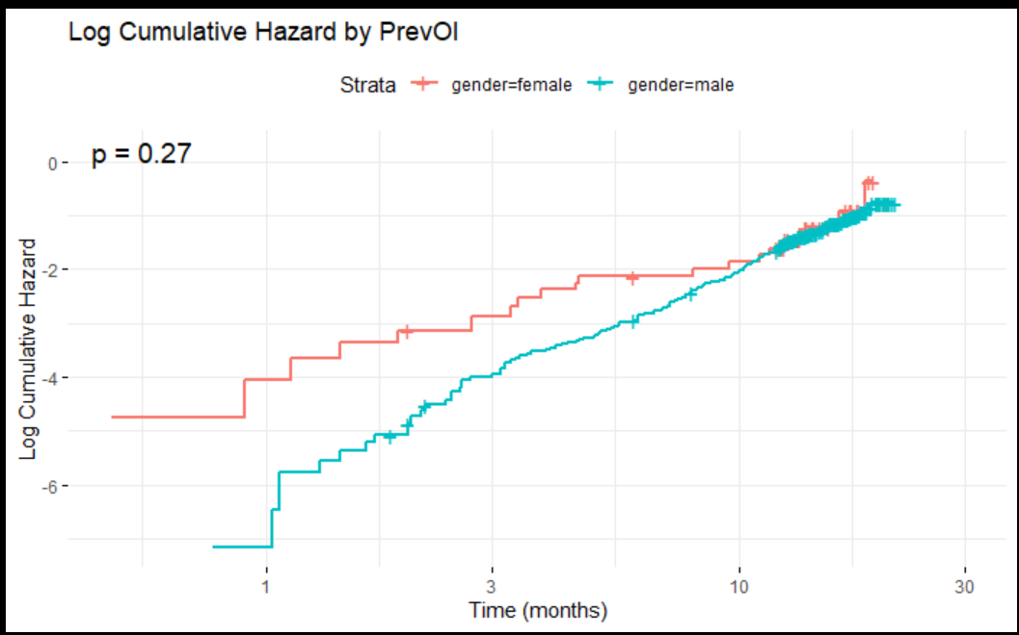
R5: Is there a difference in survival between male and female patients?
Null Hypothesis (H0): Gender does not affect survival.
Alternative Hypothesis (H1): Male or female patients have different survival outcomes.
Coefficient (coef): -0.4585
Hazard Ratio (exp(coef)): 0.6322
p-value: 0.0623 (borderline significance)
Interpretation:
The hazard ratio for gender (male vs female) is 0.6322, suggesting that male patients have approximately a 37% lower risk of death compared to female patients.
This result is on the borderline of statistical significance (p = 0.0623), which indicates that we might cautiously consider the possibility that male patients have a lower risk of death, but we do not have strong enough evidence to confirm this.

Slide 13
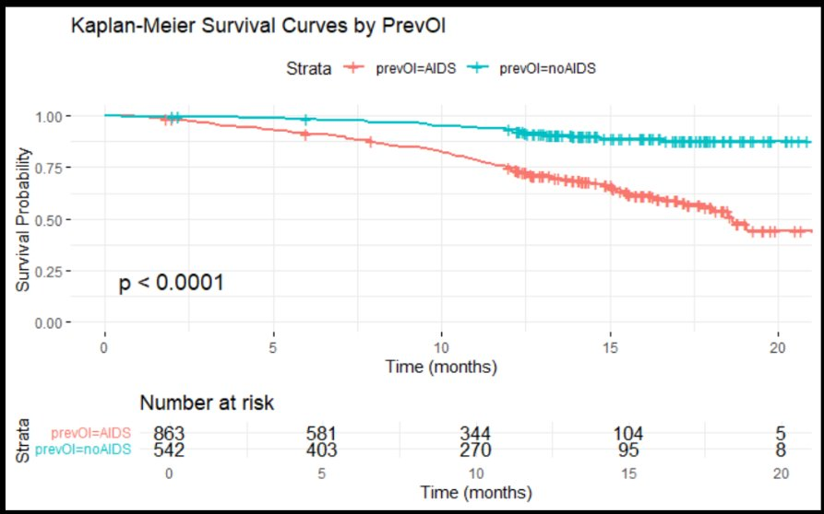
R6: Do patients with a previous AIDS diagnosis have a higher risk of death compared to those without?
Null Hypothesis (H0): Previous AIDS diagnosis does not affect survival.
Alternative Hypothesis (H1): Patients with previous AIDS diagnosis have a different risk of death compared to those without.
Coefficient (coef): -1.4240
Hazard Ratio (exp(coef)): 0.2407
p-value: 3.16e-10 (highly significant)
Interpretation:
The hazard ratio for previous AIDS diagnosis (AIDS vs noAIDS) is 0.2407, indicating that patients with no previous AIDS diagnosis have a 76% lower risk of death compared to those with a previous AIDS diagnosis.
This result is highly statistically significant (p < 0.001), providing strong evidence that a previous AIDS diagnosis is associated with a much higher risk of death.

Slide 14
Summary
A person diagnosed with AIDs has a lower chances of survival as compared to someone without AIDs.
Gender has marginal significance in determining the survival rate with males having higher chances of survival as compared to females.
In contrast to the belief of drug influence on person survival, type of drugs are statistically insignificant in determining the mortality rate of a person.
Time shows a positive trend in influencing CD4 count, suggesting gradual improvements, while a history of previous opportunistic infections significantly reduces CD4 count levels, highlighting the long-term impact of these infections on immune recovery.

